Slide 1
Charity Management System
~Mini project

Slide 2
B
C
A
Teammates
Kunchala Sree Kailash
Cse – A
24KB1A05W1
kunchalasreekailash1807@gmail.com
M.balaji
Cse - A
24KB1A05AQ
mbalaji4321@gmail.com
Shaik Mukarum (team lead)
Cse - A
24KB1A05HY
shaikmukarum@gmail.com

Slide 3
A
B
C
Shaik Mukarum (team lead)
Cse - A
24KB1A05HY
shaikmukarum@gmail.com
Kunchala Sree Kailash
Cse – A
24KB1A05W1
kunchalasreekailash1807@gmail.com
M.balaji
Cse - A
24KB1A05AQ
mbalaji4321@gmail.com

Slide 4

Problem statement:
Inefficient Data Management
Donor Relationship Challenges
Resource Allocation Issues
Limited Visibility & Reporting
Compliance Burden
Volunteer Coordination Complexities
Technology Gap

Slide 5
Solution:
Streamlined Data Management
Integrated Platform Approach
Enhanced Donor Management
Optimized Resource Allocation
Comprehensive Reporting Suite

Slide 6
Flowchart of donor
Start
Registration
Login
Donor menu
Category of donation
Enter description
end

Slide 7
Flowchart of volunteer
Start
Registration
Login
volunteer menu
View donor request
View donor details
Request admin
View request status
End

Slide 8
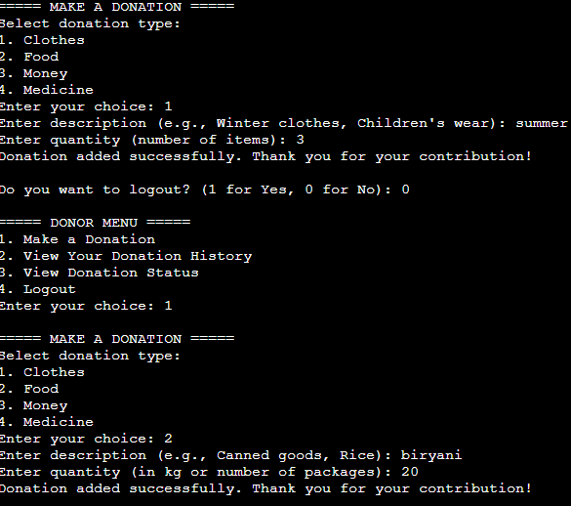
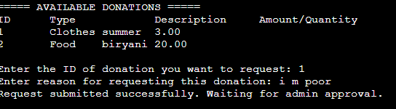
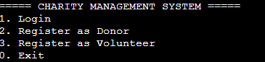
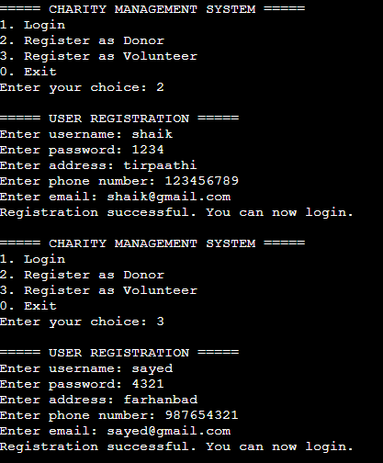
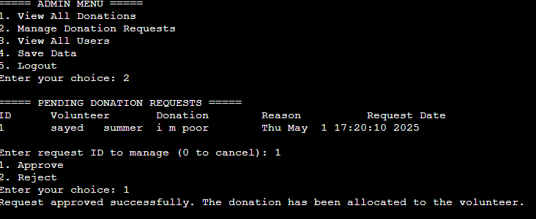
Output:

Slide 9

Thank you
Presentation designer:
Shaik Mukarum
Project report:
Kunchala Sree Kailash
Technical support:
M.balaji
Code writer :
Claude.ai
Coding Language:
C
Data structures
Project guide :
B.Sruthi(Assistant Professor)
Special thanks to:
Shivan Raj
byte xl

